Slide 1

ADVERTISEMENT CAMPAIGN ANALYSIS
GROUP 8

Slide 2
TEAM MEMBERS
YATHARTH GUPTA
ANSUMAN PAL
MD ABDUL GAFOOR
SHREEVATHSAN
POORNA CHANDRA
LALITHA CHANDRA MYTHILY MANOGNA KODURI
KAILASH SINGH
COLLINS ACHEAMPONG OFORI
VINAY KATTIRAPALLI
JETHIN REDDY
VYSHNAVI RAO PONNAMANENI

Slide 3

SUPERHERO U
GLOBALSHALA
Superhero U was an endeavor to empower imaginative and fervent young minds to make the best possible use of their skills and creativity.
It was a competitive event that was targeted towards providing an encouraging and equal educational opportunity to the budding stars.

Slide 4

FACEBOOK ADVERTS
The competition proved to be an exciting assessment of the ingenuity and intellect of the participants.
The competitors joined ‘Superhero U’ as individuals or in teams.
Divided into the high school and college categories, ‘Superhero U’ was conducted in three rounds – preliminary, semi-final and final

Slide 5

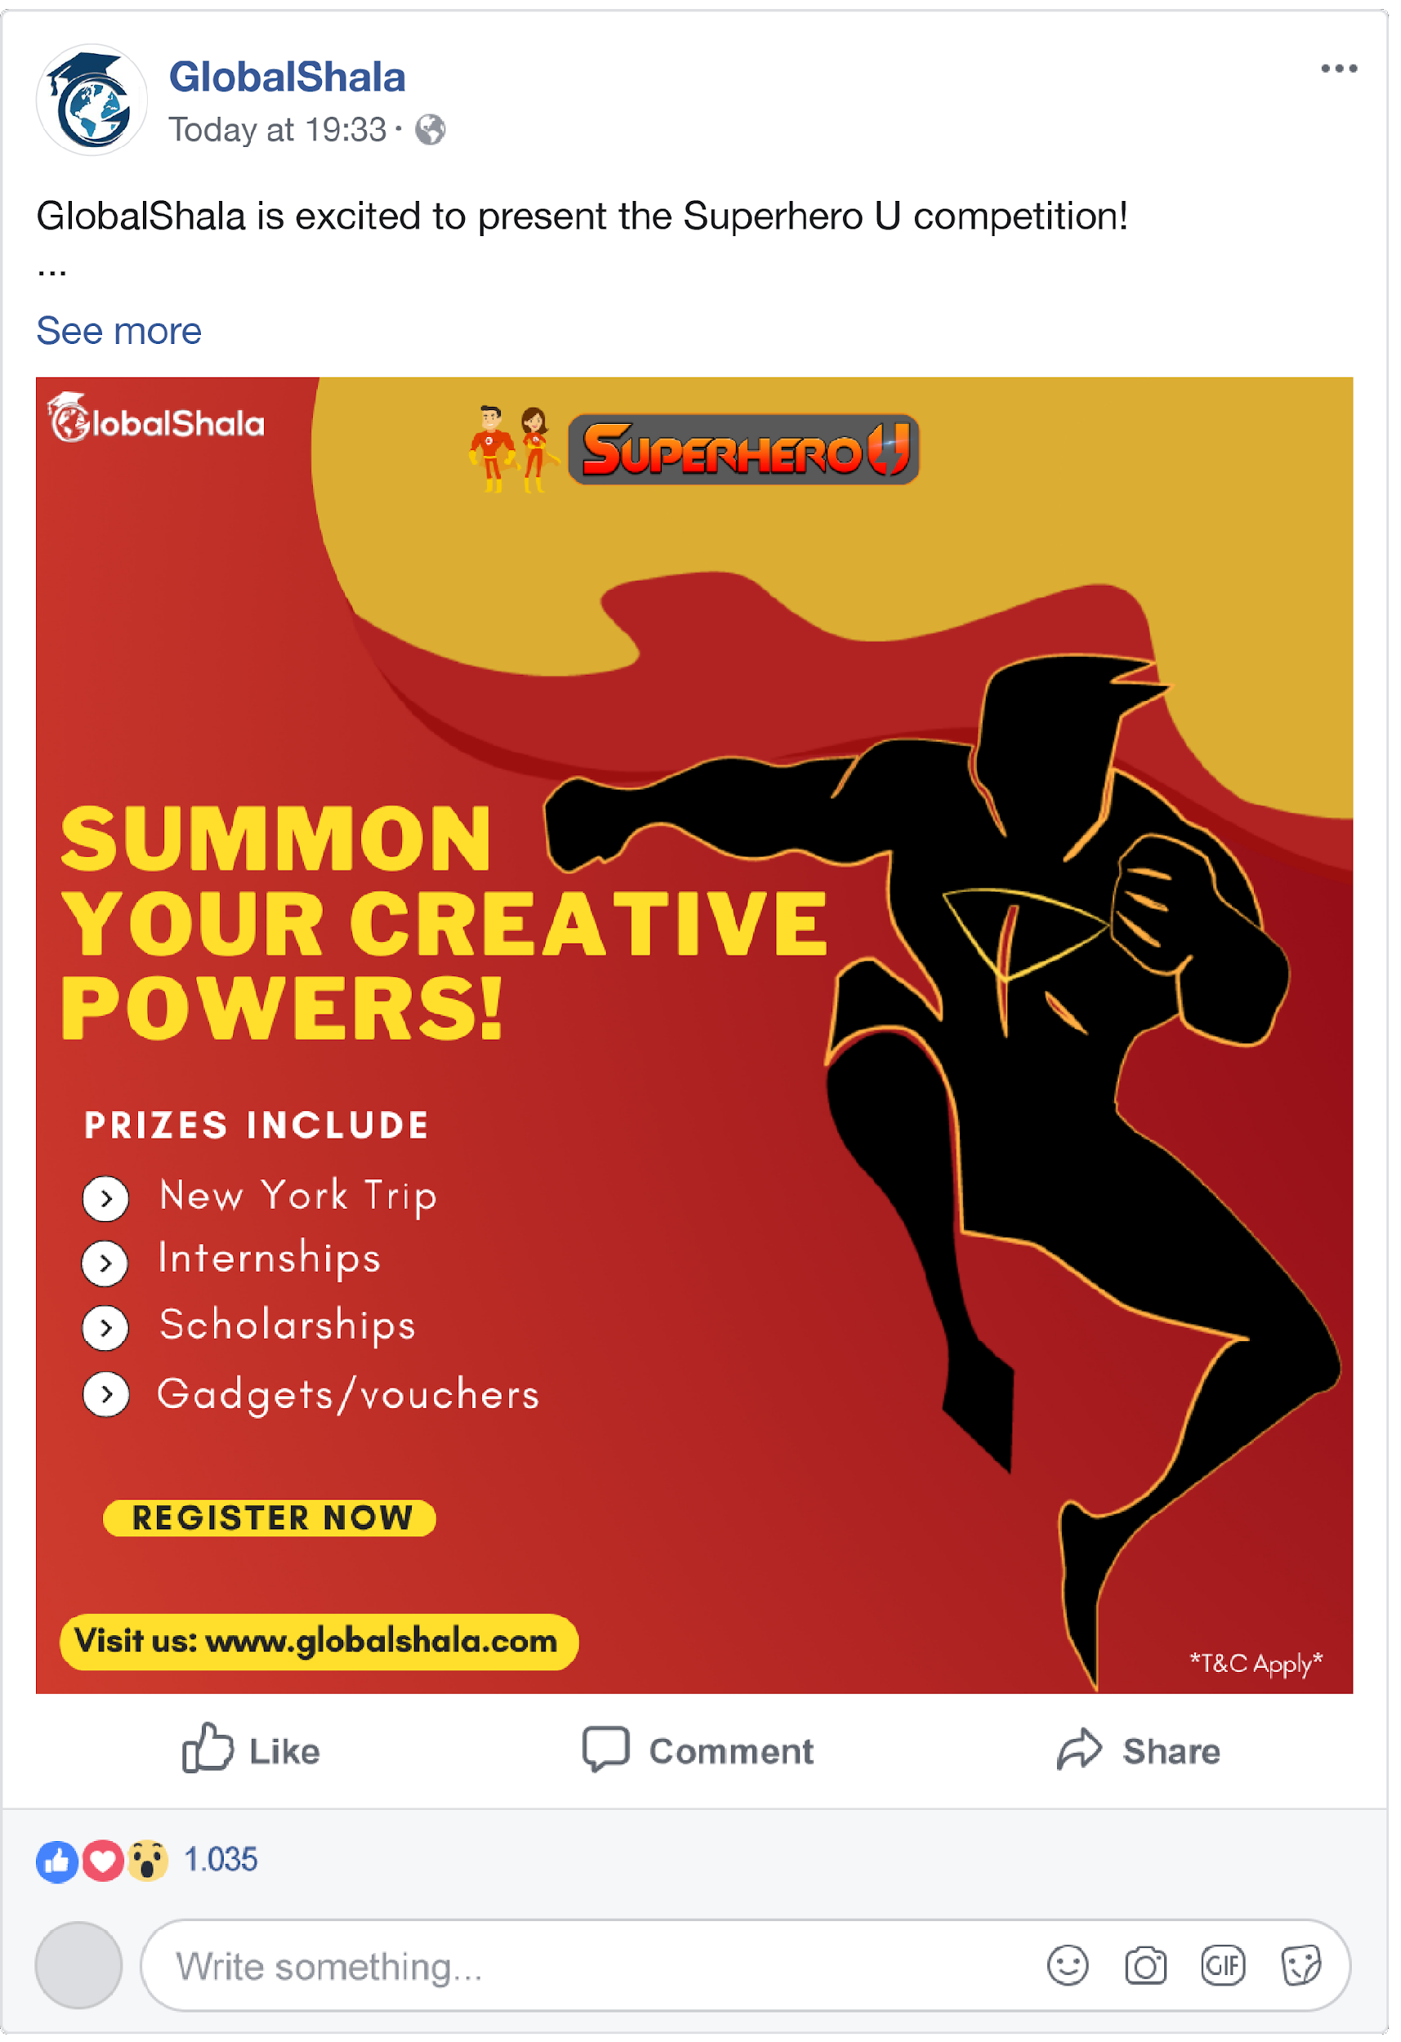

FACEBOOK ADVERTISEMENTS
Facebook is a social networking platform that allows users to connect with one another and share text, photos, and videos.
This allows businesses, such as GlobalShala, to pay for Facebook ad campaigns.
The type of ad that GlobalShala uses is a basic image ad, also known as a “Link Click” ad.
Here is an example of one of the ads they used for the Superhero U event

Slide 6
THE SUPERHERO U AND CAMPAIGNS
GLOBALSHALA PAYS FOR ITS FACEBOOK AD CAMPAIGNS.
EACH CAMPAIGN HAS THE FOLLOWING INFORMATION
CAMPAIGN ID | CAMPAIGN NAME | AUDIENCE | AGE
GEOGRAPHY | REACH | IMPRESSION | FREQUENCY
CLICKS | UNIQUE CLICKS | UNIQUE LINK CLICKS (ULC) | CLICK THROUGH RATE (CTR)
UNIQUE CLICK THROUGH RATE (UCTR) | AMOUNT SPENT IN INR | COST PER CLICK (CPC) | COST PER RESULTS (CPR)

Slide 7
THE CAMPAIGN TEAM ANALYSIS
There were 10 different campaigns for superhero U.
Each campaign was analyzed to assess which one was cost effective and has good reach.
Several graphs were drawn to analyze the campaign data.
Conclusively, analysis shows that Campaign 3 should be dropped.

Slide 8
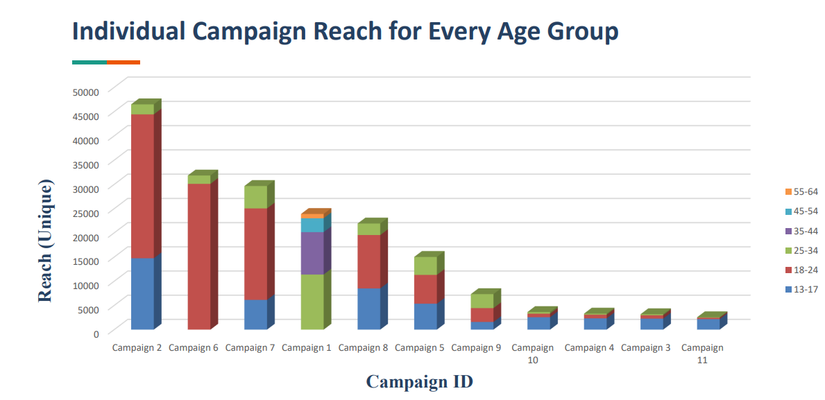
CAMPAIGN ID AND UNIQUE REACH
From the chart, we can conclude that Campaign 3 has the highest CPR and the least ULC.
Judging by the CPR AND ULC, we can conclusively state that Campaigns 3, 4, 9, 10 and 11 are poor performers while
Campaigns 2, 6, 7, and 8 are good performers.

Slide 9
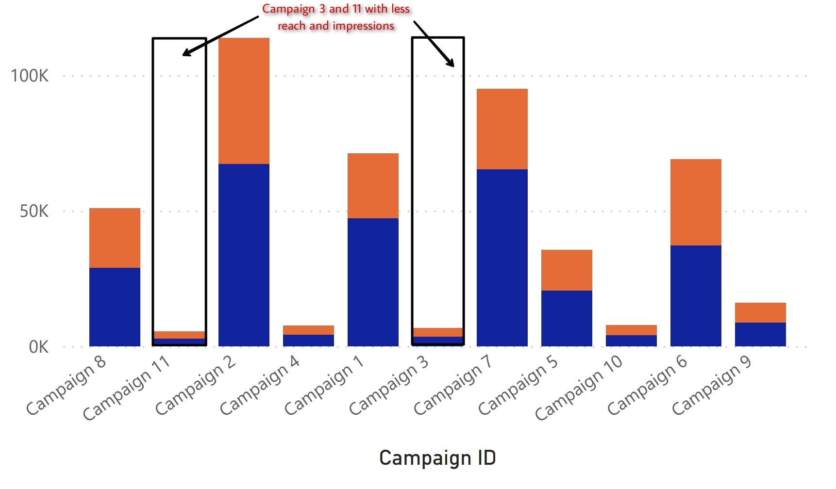
CAMPAIGN ID WITH ITS REACH AND IMPRESSIONS
CAMPAIGN 3 &
CAMPAIGN 11 HAVE
LOWEST REACH AND IMPRESSIONS AMONG OTHER CAMPAIGNS.

Slide 10
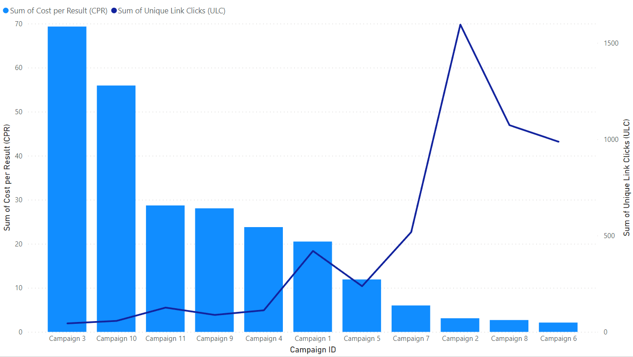
COST PER RESULT (CPR) FOR CAMPAIGN DATA
COST PER RESULT IS HIGHEST FOR
CAMPAIGN 3.
IT MEANS TO WE HAVE TO SPEND HIGHEST AMOUNT OF MONEY FOR EACH RESULT.

Slide 11
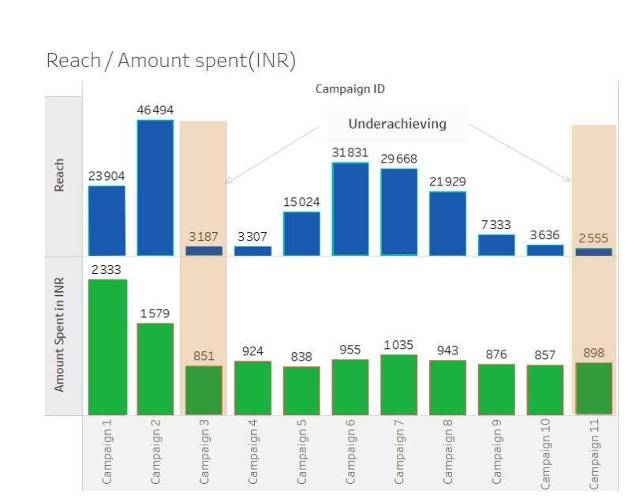
AMOUNT SPENT VS REACH
THIS GRAPH SHOWS THE RELATION BETWEEN AMOUNT SPENT(IN INR) VS REACH BY CAMPAIGN.
BY GRAPH, WE SEE THAT
CAMPAIGN 3 GIVES THE LOWEST REACH AND LEAST COST EFFICIENT.

Slide 12
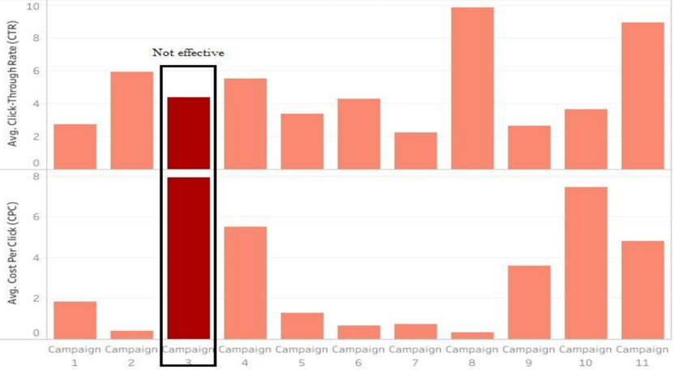
Avg CPC and Avg CTR vs Campaign
IT HAS BEEN SEEN THAT CAMPAIGN 3 HAS HIGHEST AVERAGE COST PER CLICK (CPC) AND LOWEST AVERAGE CLICK THROUGH RATE (CTR).
HENCE, IN COMPARISON WITH REST OF THE CAMPAIGN 3 IS LEAST COST EFFICIENT AS IT IS NOT ABLE TO GAIN MAXIMUM ATTENTION OF AUDIENCE.

Slide 13
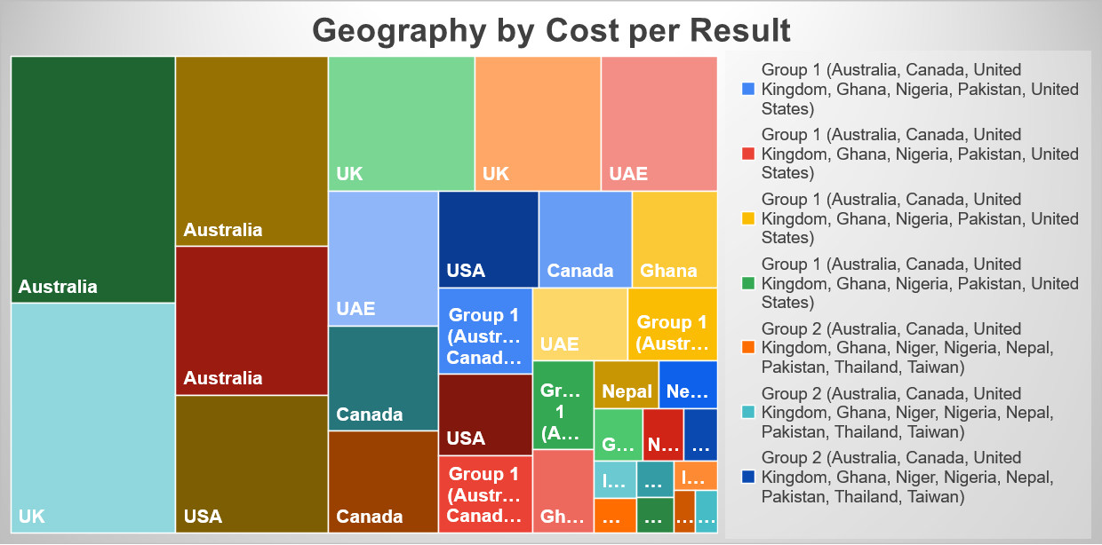
GEOGRAPHY vs COST PER RESULT
PLOTTING GEOGRAPHY BY COST PER RESULT (CPR) .
WE SEE THAT AUSTRALIA AND UK HAVE HIGHEST COST PER RESULT
CAMPAIGN 3 - AUSTRALIA AND UK ARE LEAST COST EFFICIENT AND HENCE, MUST BE DROPPED.

Slide 14


CONCLUSION
After visualizing and comparing the results, we came to a conclusion that Campaign 3 is having the lowest number of reaches and impressions while also having a higher amount spent.
Therefore, Campaign 3 should be dropped due to low result and least cost efficiency.

Slide 15




Thank You
Group 8

